Slide 1
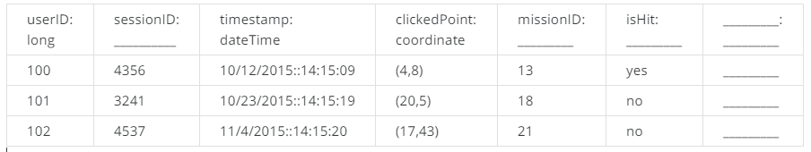
primary key that uniquely identify each click is userID & SessionID & timestamp
No other column have to be added car all need information can be retrieved using foreign key:
  userId for all information about user and related teams (user is part of only 1 team at any team)
  sessionID for all details of session for the specific UserId
  MissionID for all details of mission such as mission criteria (eg Flamingo types, criteria to calculate score etc)
  cell grid are identified with coordinate in order to retrieve information
  score could be calculate as sum of all clicks considering if the correct type of flamingo has been hit or not (-1) accordind the mission criteria
userID: long | sessionID: long | timestamp: dateTime | clickedPoint: coordinate | MissionID: int | isHit: Boolean
 | because it grows rapidly |  |  | MissionID int should be enough because there are limited missions | It could be just TRUE (yes) or FALSE (no)

